Slide 1

Beijing Multi-Site Air Quality Analysis
By: Roxanne Prajapati
Notes:
My name is Roxanne Prajapati and, I will be presenting my analysis of the Beijing Air Quality dataset. This analysis focuses on understanding pollution patterns across different stations and identifying key insights from the data.

Slide 2
DataSet Overview
Beijing Multi-Site Air Quality Dataset (UCI)
Hourly data from March 2013 – February 2017
12 monitoring stations across Beijing
Includes:
Pollution (PM2.5, PM10, SO2, NO2, CO, O3)
Weather (TEMP, PRES, etc.)
Stations: Aotizhongxin, Changping, Dingling, Dongsi, Guanyuan, Gucheng, Huairou, Nongzhanguan, Shunyi, Tiantan, Wanliu, Wanshouxigong
Notes:
The dataset is from the Beijing Multi-Site Air Quality dataset from UCI. It contains hourly air quality data from March 2013 to February 2017. The data comes from 12 monitoring stations across Beijing, such as Aotizhongxin, Dongsi, and Tiantan. It includes pollution variables like PM2.5 and weather data.
Next, I will explain how the data was prepared before the analysis.

Slide 3
Data Preparation
Excluded unrelated(noise) files
Combined multiple CSV files
Created datetime column
Sorted by station and time
Filled missing values using forward-fill and backfill
Removed duplicates
Notes:
First, I excluded unrelated(noise) files
Then I combined all CSV files into one dataset. I created a datetime column using year, month, day, and hour. I sorted the data by station and time to keep it in order. Missing values were filled using forward-fill and backfill. Finally, duplicate rows were removed.

Slide 4
FINDINGS
Notes:
After preparing the data, I started analyzing it. The first finding is about PM2.5 variation.

Slide 5
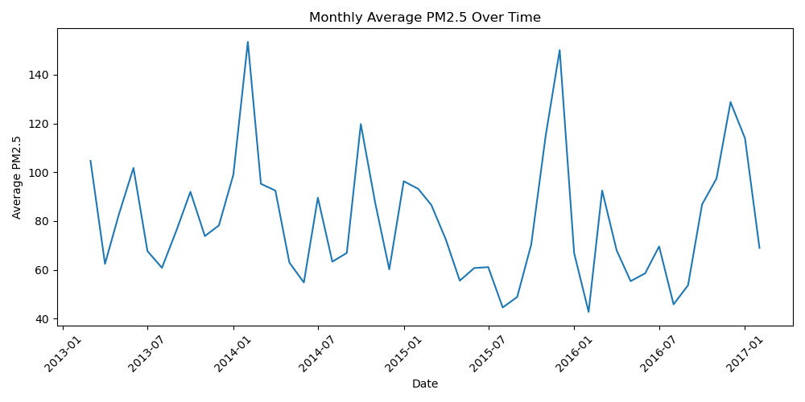
PM2.5 variation
PM2.5 values vary a lot
Some very high values observed
Indicates unhealthy pollution levels
Notes:
From the analysis, I found that PM2.5 values vary a lot. There are some very high values, which means pollution can reach unhealthy levels.
This graph shows the monthly average PM2.5 over time. We can see that the values go up and down, which means air pollution is not stable. There are some periods where the values are very high, which indicates that pollution can reach unhealthy levels.

Slide 6
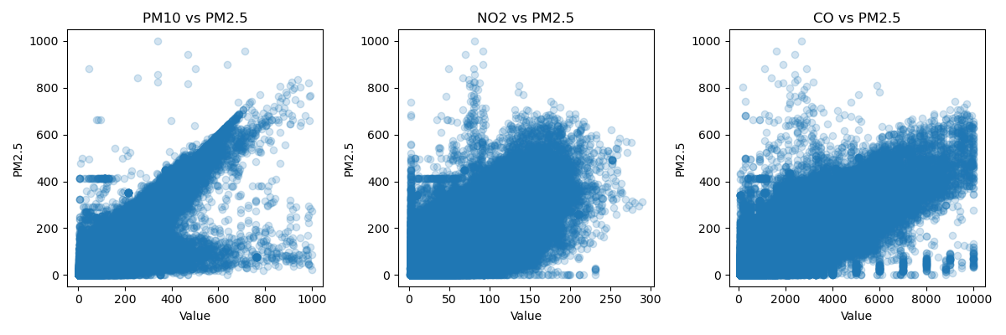
Pollutants Relationship
PM10, NO2, CO are positively related to PM2.5
Pollutants tend to increase together
Notes:
I also found that pollutant variables like PM10, NO2, and CO are positively related to PM2.5.
This graph shows the relationship between PM2.5 and other pollutants. We can see an upward pattern in all three graphs, which means that as PM10, NO2, and CO increase, PM2.5 also increases. This shows that pollutants are positively related.

Slide 7
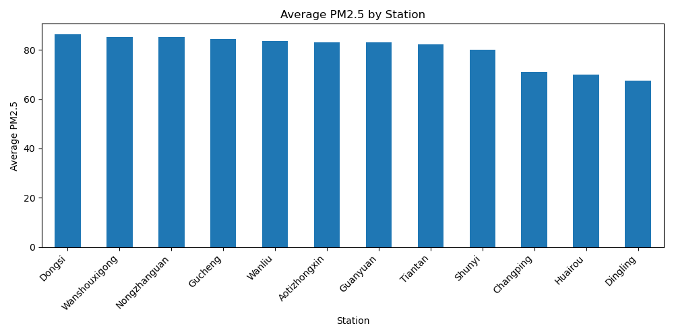
Station Differences
Pollution levels differ across stations
Some locations have higher average PM2.5
Notes:
Another finding is that pollution levels are different across stations.
This graph shows the average PM2.5 for each station. We can see that some stations have higher values than others, which means pollution levels vary depending on location.

Slide 8
Conclusion
Pollution varies by time and location
Multiple factors affect PM2.5
Data helps understand air quality patterns
Notes:
In conclusion, air pollution changes over time and also varies depending on the location. Some stations have higher pollution levels than others, and there are periods where pollution becomes very high.
The analysis also shows that multiple factors affect PM2.5 levels, especially other pollutants like PM10, NO2, and CO, which tend to increase together.
Overall, this analysis helps us better understand how air quality behaves and shows that pollution is influenced by both time and location.

Slide 9
Thank you

